Slide 1
Airbnb Rentals
Fundamentals of Investing in the Entertainment Capital - Las Vegas
Kaivan Shah
Notes:
Good Afternoon everyone, The aim is to help an investor make a data driven decision to invest in property to list it as an airbnb that would yield high booking rates in Las Vegas. We conducted a market research registering the pros and cons of Las Vegas as an airbnb hub. The first priority was to analyze factors that make it a favorable property such as location, type and size. This analysis was a blend of market driven and data driven effort to narrow down the options. Once the type of property was finalized, the focus was to help the investor decide on the management style, which would alleviate the customer engagement This analysis is completely based on the kind of user experience the customers are expecting when they visit Vegas. We looked into the prudent characteristics of the host such as customer interaction on the platform and the kind of amenities offered. This was done by inspecting and consolidating the most frequently asked for services. On understanding the important variables, we built a predictive model which would help envision a good investment. We would be analysing in detail on which is the most favorable configuration of a property.
This process was carefully crafted taking multiple variable combinations and iterations into consideration which would be in the investor's best interest. This two part analysis can be used as a tool to understand importance of underlying elements in the Las Vegas airbnb market and predict the possibility of an investment being a successful one.

Slide 2
TABLE OF CONTENTS
Kaggle Competition
Objective 2
01
04
Business Case
Prediction
02
05
Recommendations
Objective 1
06
03
Notes:
Taking a quick look at what we have to offer

Slide 3
INTRODUCTION
Airbnb Experience
A Personalized experience at an affordable price
Experience Vegas by staying with the Nevadans.
Notes:
Now what is the Airbnb experience, it is a personalized experience at an affordable price and also an opportunity to live and learn the local culture

Slide 4
Kaggle
Competition
01
Notes:
Let’s take a look at how we went about the Kaggle competition

Slide 5
Building the Model
Data Processing
Imputing Missing Values, Factorizing, Transformation, Calculated Field, Pattern Extraction, String Manipulation, Recoding
Variables
accommodates, amenities, availability, bathrooms, bed_type, bedrooms, cancellation_policy, cleaning_fee, extra_people, guests_included, host_about, host_has_profile_pic, host_identity_verified, host_is_superhost, host_listings_count, host_response_time, host_since, host_verifications, instant_bookable, is_location_exact, maximum_nights, minimum_nights, price, require_guest_phone_verification, review_scores, room_type, security_deposit, transit,extra_people_fee
Final Method
Random Forest with 10-fold cross-validation
AUC Score
0.93161
Notes:
After skimming through data and noticing inconsistencies, we worked on the basic cleaning such as converting string variables in to numeric variables, namely the price. We dealt with some missing values through domain knowledge For eg; cleaning fee, which was assumed to be zero if it wasn’t explicitly mentioned
Next, we created dummy variables for certain amenities as well as host verifications on the basis of their frequency and we only included the ones which were statistically significant
We also re-coded some variables such as host response time, cancellation policy to deal with rank deficiency error
Next, we created new variables hostDays (that counts the number of days since the host is registered) and countAmenities(which represents total no of amenities that a property has)
Finally we decided to go with the Random forest model with 10 fold cross validation which yielded an AUC score of 0.931 on 30% Test Data

Slide 6
Step-1 (Data Preprocessing)
Converting character to numeric and numeric to factor e.g price, security_deposit, cleaning_fee, high_booking_rate,extra_people_fee
Dealing with missing values on the basis of domain knowledge and inbuilt library (stringR),e.g Cleaning fee, Bedrooms, bathrooms, security deposit, host_lisitings_count
Creating dummy variables for categorical fields e.g Dyer, Hair Dryer, Laptop friendly workspace, Hot water, Heating
Notes:
Let’s take a look at Las Vegas as a market, Las V has several regulation constraints regarding rental properties such as the one where owner or property manager needs to stay in the house and others where hosts are required to obtain several licenses and pay annual fees for each rental units
Despite this, Las Vegas is a promising market to buy an AirBnb because………...
Airbnb stays in LV has yearly predicted growth of 7.9%
It has almost all year long influx of visitors.
In 2019, around 42 Million visitors were recorded
AirBnb’s typical competition: Hotels
AirBnb rental will typically cost half of Hotels like Hilton for a week long stay.

Slide 7
Converting character variables into categorical variables and grouping infrequent categories to 'other' categories. E.g Cancellation Policy, Property Type, Host Response Time
Creating new variables (Host days,Count of Amenities,Distance from Centre)
Notes:
Most of the categ

Slide 8
Step-2 (Variable Selection )
Variables for the model were selected using different methods and various algorithms were used for the variable selection.
Domain Knowledge (Most Sought)
Variance Threshold for Boolean Variables( Threshold = 0.8, Binomial Distribution)
Removing Multicollinear variables (e.g Beds and Bedrooms)
Random Forest (Did not show up Host_is_superhost)
Notes:
Let’s take a look at Las Vegas as a market, Las V has several regulation constraints regarding rental properties such as the one where owner or property manager needs to stay in the house and others where hosts are required to obtain several licenses and pay annual fees for each rental units
Despite this, Las Vegas is a promising market to buy an AirBnb because………...
Airbnb stays in LV has yearly predicted growth of 7.9%
It has almost all year long influx of visitors.
In 2019, around 42 Million visitors were recorded
AirBnb’s typical competition: Hotels
AirBnb rental will typically cost half of Hotels like Hilton for a week long stay.

Slide 9
Step-3 (Model Implementation)
Logistic Regression (L1 penalty)
KNN
Random Forest (5-CV and 10-CV)
Gradient Boosting (5-CV and 10-CV)
XGBoost (5-CV and 10-CV)
Notes:
Let’s take a look at Las Vegas as a market, Las V has several regulation constraints regarding rental properties such as the one where owner or property manager needs to stay in the house and others where hosts are required to obtain several licenses and pay annual fees for each rental units
Despite this, Las Vegas is a promising market to buy an AirBnb because………...
Airbnb stays in LV has yearly predicted growth of 7.9%
It has almost all year long influx of visitors.
In 2019, around 42 Million visitors were recorded
AirBnb’s typical competition: Hotels
AirBnb rental will typically cost half of Hotels like Hilton for a week long stay.

Slide 10
Business
Case
02
Notes:
Moving on to the business case

Slide 11
LAS VEGAS - MARKET OVERVIEW
Airbnb has a yearly growth of 7.9% predicted
Almost all year long influx of visitors.
In 2019, around 42 Million visitors were recorded
AirBnb’s typical competition: Hotels
AirBnb rental will typically cost half of Hotels like Hilton for a week long stay.
Notes:
Let’s take a look at Las Vegas as a market, Las V has several regulation constraints regarding rental properties such as the one where owner or property manager needs to stay in the house and others where hosts are required to obtain several licenses and pay annual fees for each rental units
Despite this, Las Vegas is a promising market to buy an AirBnb because………...
Airbnb stays in LV has yearly predicted growth of 7.9%
It has almost all year long influx of visitors.
In 2019, around 42 Million visitors were recorded
AirBnb’s typical competition: Hotels
AirBnb rental will typically cost half of Hotels like Hilton for a week long stay.

Slide 12
Objective 1
To recommend a property that will get high booking rates
03
Notes:
We divided our business case into 2 main objectives, the first one was to recommend a type of property that will get high booking rate

Slide 13
RESEARCH QUESTIONS?
01
02
03
Which will be a favorable location for buying the property?
What type of property should the investor buy?
What should be the property layout?
Notes:
To start with selecting variables for our model, we went about asking some questions which would provide us some insights
Question 1 - Which will be a favorable location for buying the property
Question 2 - Pertains to a House / Apartment / Condo
Question 3 - Explain that we are trying to figure out the number of beds, bathroom, the number of guest that it can accommodate, etc.

Slide 14
VARIABLES
12
Number of Variables added from domain knowledge
4
Number of Variables included in the final model
accommodates, amenities, bathrooms, bedrooms, beds, latitude, longitude,
neighborhood_overview, property_type, room_type, transit, zipcode
Notes:
As per our domain knowledge we selected 12 variables from the data dictionary which will answer our research questions for objective 1. We finally selected 4 variables accommodates, property_type, room_type, transit to be included in our final model on the basis of statistical significance and exploratory analysis

Slide 15
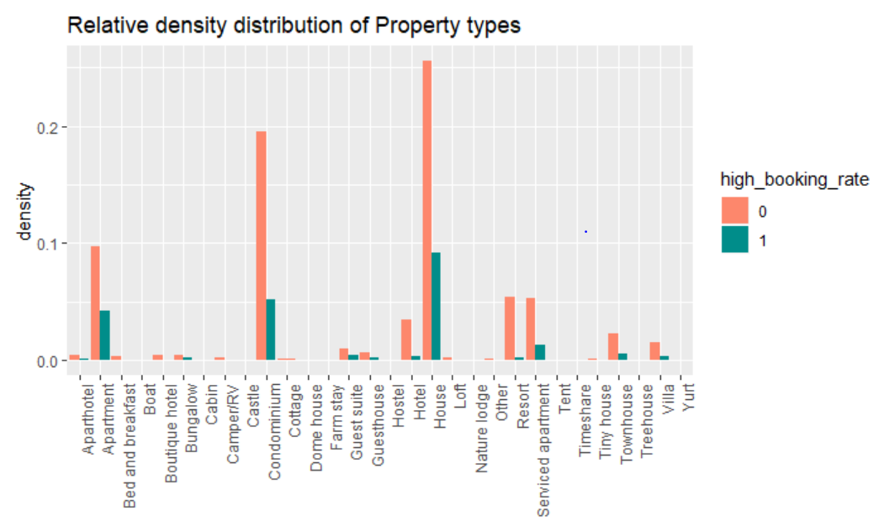
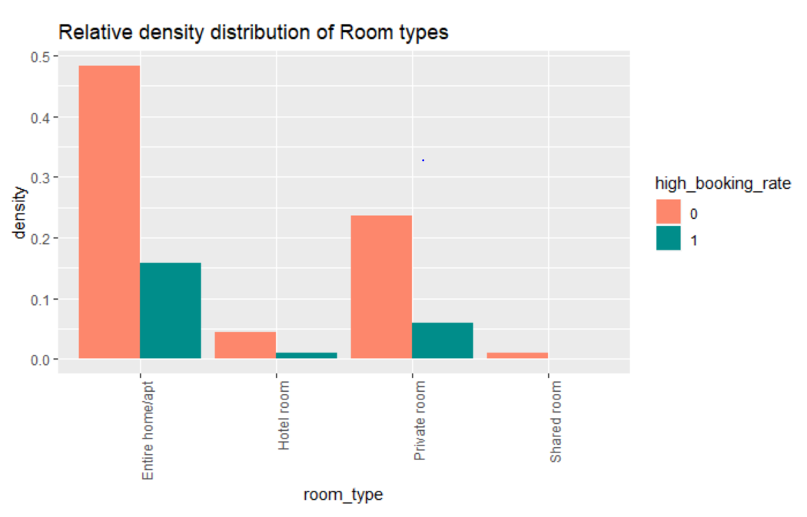
EXPLORATORY ANALYSIS
Notes:
We went ahead and plotted graphs Property type and Room type distributions against density. We would advise to avoid investing in Villas, Resorts and Yurts. There is a greater possibility for getting higher booking rates for houses, condos and Apartments due to changes in law we can see certain patterns in the data which can be addressed from here.
On the right, for the room_type variable...We can see that entire apartment and private room are most preferable to buy a property while shared room are not preferred much

Slide 16
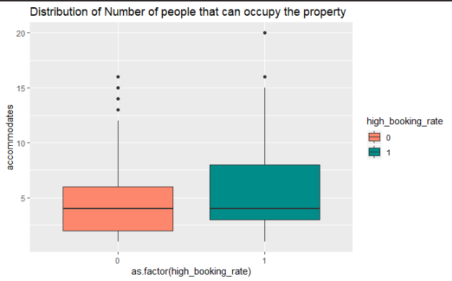
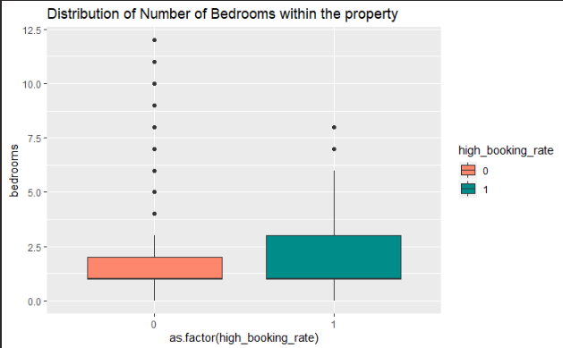
EXPLORATORY ANALYSIS
Notes:
These boxplots give us an idea of what kind of property layout we should be looking for. Coming to the plot on the left, we see the distribution of how many guests the property can accommodate. As per the plot on the right, we can see that properties with greater than 6 bedrooms have higher number of outliers. We should plan to invest in standard properties with 2-5 bedrooms which can accomodate 3-8 guests

Slide 17
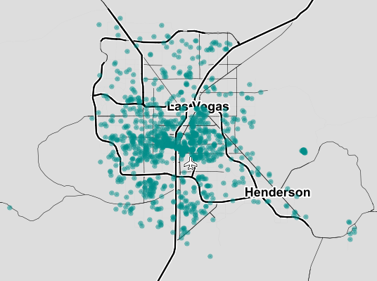
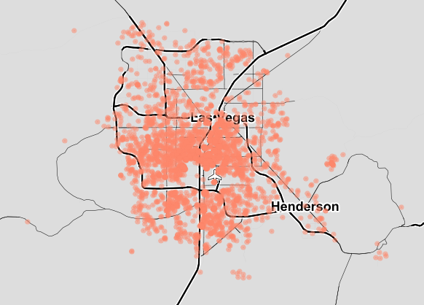
EXPLORATORY ANALYSIS
High Booking Rate: 1
High Booking Rate: 0
Notes:
Here, we tried to explore location based booking rates, but properties with high and low booking rates are spread similarly. Looking at the map there is cluster of properties at the center. This is due to the proximity to tourist attractions such as the Strip, Fremont Street and Downtown Vegas. This would be a preferable location.

Slide 18
Objective 2
Recommendations to effectively manage the property
04
Notes:
Moving on to our second objective where we make recommendations to effectively manage the property

Slide 19
RESEARCH QUESTIONS?
01
02
03
What should be the ideal host benchmarks?
What are the essential amenities to be provided?
What should be the optimal reservation policy?
Notes:
Question 1 - This is basically how the host interacts with the customers on the airbnb platform such as how quickly does the host respond to customer queries, whether host is verified or not, overall ratings of host, etc.
Question 2 - What are the essential amenities to be provided
Question 3 - This is where we talk about how customer friendly the reservations policies are, such as cancellation policies which may include grace periods and if the property is instantly bookable.

Slide 20
VARIABLES
23
Number of Variables added from domain knowledge
17
Number of Variables included in the final model
hostDays, hostVerifications, host_listings_count, host_response_time, host_is_superhost, host_has_profile_pic, host_identity_verified, maximum_nights, minimum_nights, price,
cleaning fee, require_guest_phone_verification, security_deposit, AmenitiesCount, dryer, hot water, hairdryer, cancellation policy, dummyTransit, instant_bookable, dummyHostLocal
Notes:
As per our domain knowledge we selected 23 variables from the data dictionary which will answer our research questions for objective 2. We finally selected 17 variables to be included in our final model on the basis of statistical significance and exploratory analysis

Slide 21
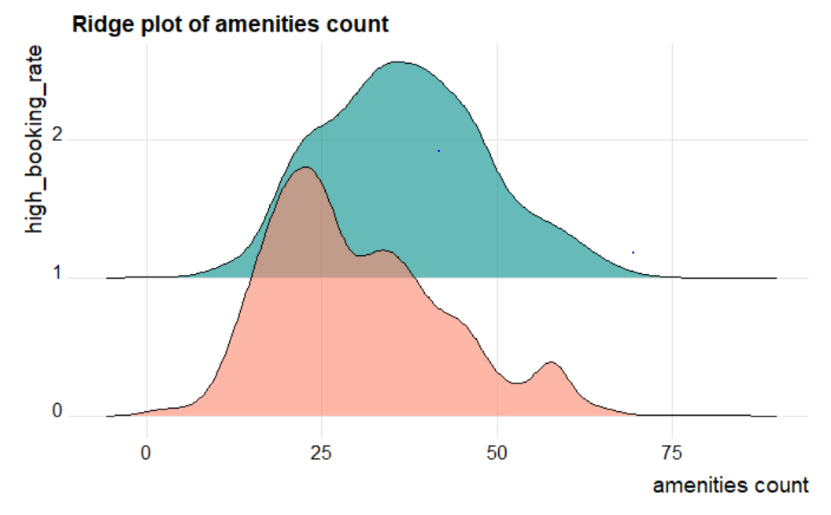
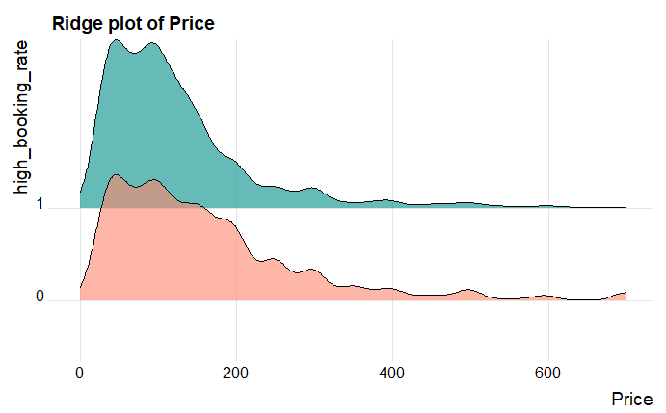
EXPLORATORY ANALYSIS
Notes:
Here we have plotted amenitiesCount variable(which is total number of amenities that listing provides) and price variable
1. In the first plot we can see that The total number of amenities are significantly higher for properties with high booking rate as compared to those with low booking rate. This indicates that the investor should make sure they provide amenities in the range of 20 to 50.
2. Now talking about price...higher number of properties are booked that lie within the range of 0 to $200 and the properties that are on the expensive side end up going unbooked more often.

Slide 22
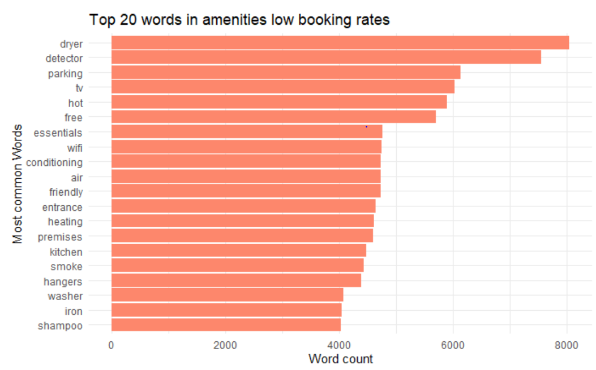
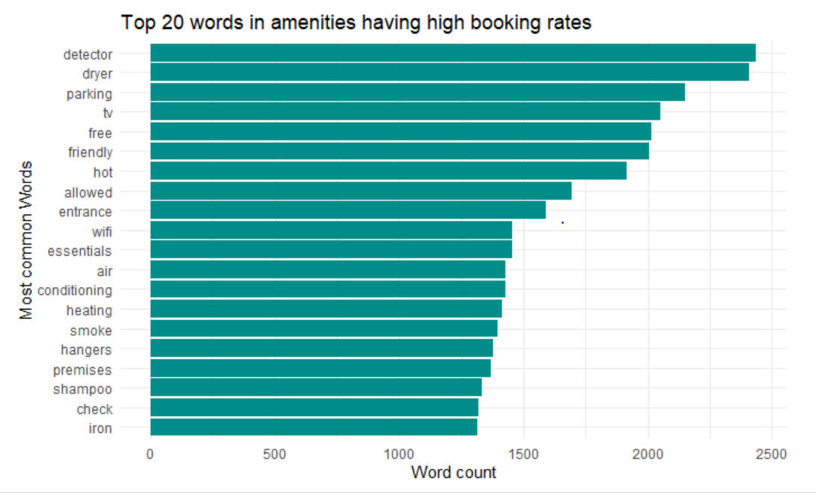
EXPLORATORY ANALYSIS
Notes:
Here we text mined the amenities and found out that basic amenities like Detector / AC / Heating / Dryer / Hot Water / Cable / TV and Wifi have a higher frequency.
We then created our dummy variables based on the frequency of amenities and on their statistical significance.

Slide 23
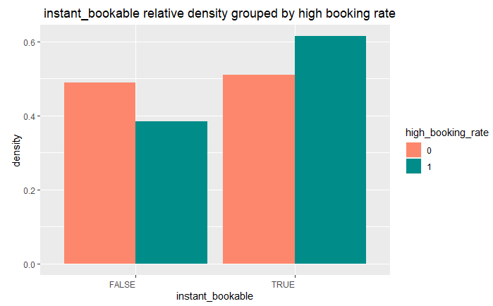
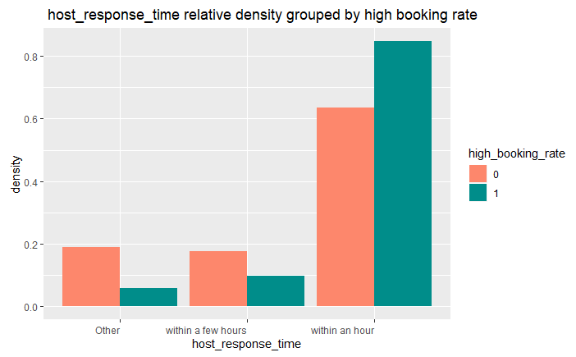
EXPLORATORY ANALYSIS
Notes:
1. On the left we have plotted the graph for instant_bookable variable...We can see that the option of instant booking contributes significantly to the booking rate. We can see that the properties with instant booking are booked more often.
2. On the right we can see that Host response time is another crucial factor for having a high booking rate. This also holds true to the claim that having a quick response time helps in attaining the status of a super host.

Slide 24
Predictive Modeling
05
Notes:
Let’s move on to our predictive model

Slide 25
OUR MODELS
01
Logistic Model
Ensemble Model
02
 | Accuracy | Specificity | ROC Value
 | 0.7967 | 0.92135 | 0.8147855
 | 0.8332 | 0.9224 | 0.874834
To understand features
To predict probability of high booking rate
Notes:
We chose mainly chose Specificity as our performance metric. It is alway better to not invest in a property that might be high booking than ending up investing in a property that has low booking probability.
We created two models at the end. Logistic and Ensemble. Our logistic model had a specificity of 0.92135 and for ensemble model(where we used Random Forest), we got specificity of 0.9224

Slide 26
Conclusion
06
Notes:
Now let’s talk about conclusion regarding various points which answers our research questions and provides recommendations to an investor

Slide 27
Location
Property Characteristics
Amenities
Transit
Best time to invest
Management
In close proximity to the Strip, Downtown, Fremont Street
Ideal property type, number of bed/bath, room type
Total number of amenities, Top amenities
Access to public transit
Lowest median prices in January and more options in September
Focus on customer interaction and flexible policy
Notes:
Consolidating our findings from market research, explo analysis and data modeling, we will talk about the mentioned points.
1. Location: We tried coming to a conclusion after analyzing location wise data, but could not find any significant result. However from our market research we would suggest the investor to buy a property near the Strip, the Downtown and Fremont Street which are relatively popular spots.
2. Property Characteristics: As devised from above, investor should plan to go for property types such as Houses, Apartments and Condos with 2-5 bedrooms.
3. Amenities: For amenities, We would recommend the owner to provide around 20 to 40 amenities and they should also make sure that they include AC / Heating / Dryer / Hot Water / Cable and Wifi for a higher booking rate.
4. Transit: It is advisable for the property to be in areas from where the public transit is easily accessible and there are ample uber and lyft rides around to get to the Strip.
5. Best time to invest: The best time to invest from a cost perspective would be in January and if the investor is willing to spend generously then September would offer a great number of property options.
6. Management: When it comes to customer satisfaction, it is very important for the host to communicate with the customer as and when required. Also, factors like instant booking and a quick response time will help.

Slide 28
FINAL RECOMMENDATION
Use our model to determine booking rate for the property and to better understand it’s features.
Notes:
Finally, our recommendation to the host would be to use our logistic model to better understand the relation of different features with probability of getting high booking rate and our ensemble model to accurately determine booking rate of the several property options.

Slide 29
07
Takeaways

Slide 30
Simple models can do the magic
Domain Knowledge Triumphs
Think from Investors perspective

Slide 31
08
Limitations

Slide 32
Vegas Changing Laws
Political Issues
User perspective Data

Slide 33
THANKS

